Slide 1
House Committee on Investments and Financial Services
February 18, 2013
Charles G. Cooper, Banking Commissioner
Texas Department of Banking

Slide 2
Department Overview
Established in 1905 by the 29th Legislature.
Granted Semi-Dependent, Semi-Independent status by 81st Legislature.
Rich tradition of professional and sound regulation.
Practices and promotes fiscal responsibility.
Reduces regulatory burden by coordinating regulatory activities with other state and federal agencies.
Ensures Texas has a safe, sound and competitive financial services system.
Regulatory oversight in the banking industry is countercyclical, and during times of economic stress there is an increased need for supervision.
Department Motto – “Tough but Fair.”

Slide 3
Profile of Regulated Entities
Regulated Entities | Number of Entities | Total Assets ($ millions)
As of September 30, 2012
Commercial Banks | 295 | 198,470 ^
Public Trust Companies | 21 Nonexempt 21 Exempt | 22,950 NA
Foreign Bank Agencies | 10 FBAs/FBB 15 Representative Offices | 75,691 NA
Money Service Businesses | 133 | 89,819
Prepaid Funeral Contract Sellers | 395 | 3160
Perpetual Care Cemeteries | 243 | 260
Private Child Support Enforcement Agencies | 10* | NA
Check Verification Entities | 4* | NA
The Department conducts examinations of entities under its supervision to better evaluate safety and soundness and compliance with state and federal laws. Total assets of the regulated entities represented in the table are approximately $390 billion.
^ FDIC financial data for insured institutions. Year-end data not available at this time.
* Registration requirement only.

Slide 4
Assets Under Supervision in Texas
Source: FDIC

Slide 5
Revenue Sources
Fees and assessments paid by regulated entities fund 100% of the agency’s expenditures.
By statute, the Department of Banking is limited to collecting fees and assessments that cover only the agency’s direct and indirect expenditures.
Expenses
A public hearing is held annually on the agency’s proposed budget. The final budget is approved by Finance Commission on an annual basis at their August meeting.
The agency follows the State Payroll, Travel, Purchasing and Procurement rules and standards for all agency expenditures.
Salaries and other personnel expenses average 81% of total expenditures.
Travel related expenses, mainly to conduct examinations, average 10% of total expenditures.

Slide 6
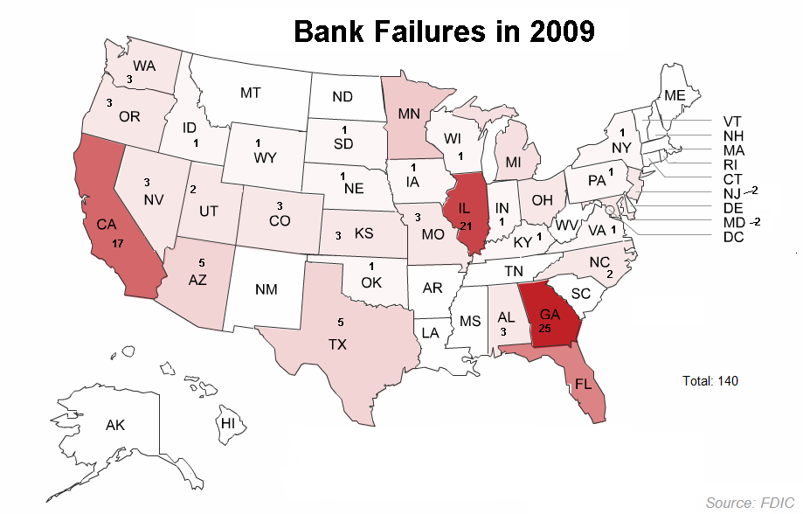
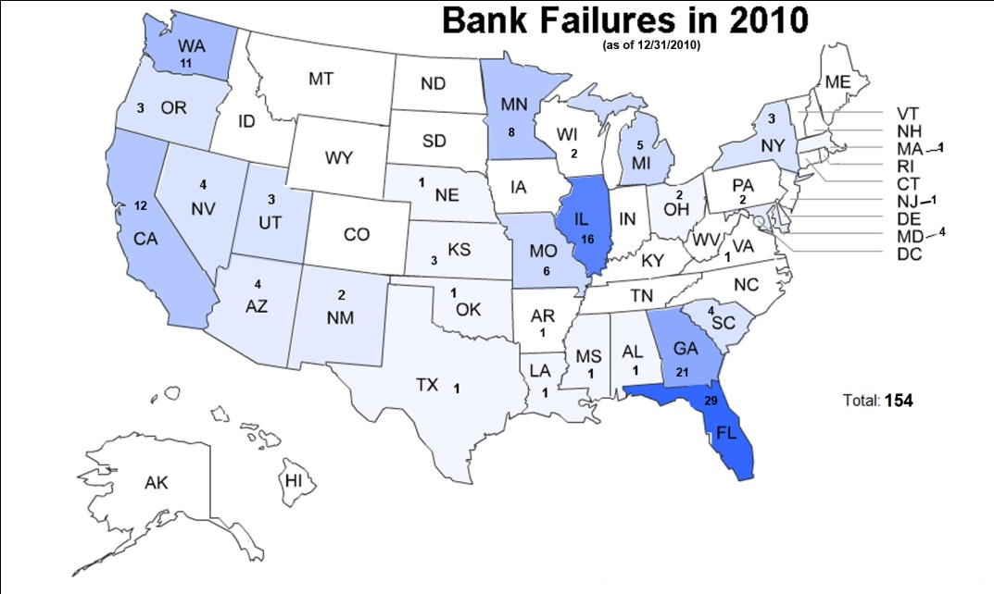
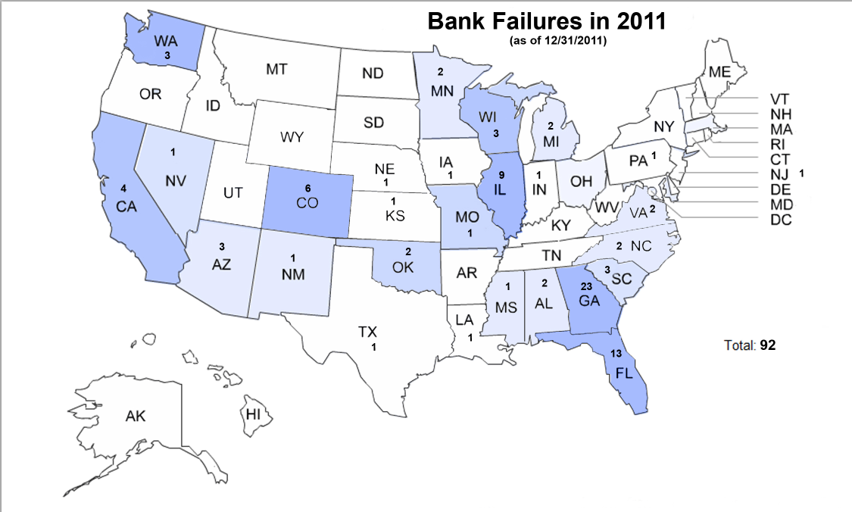
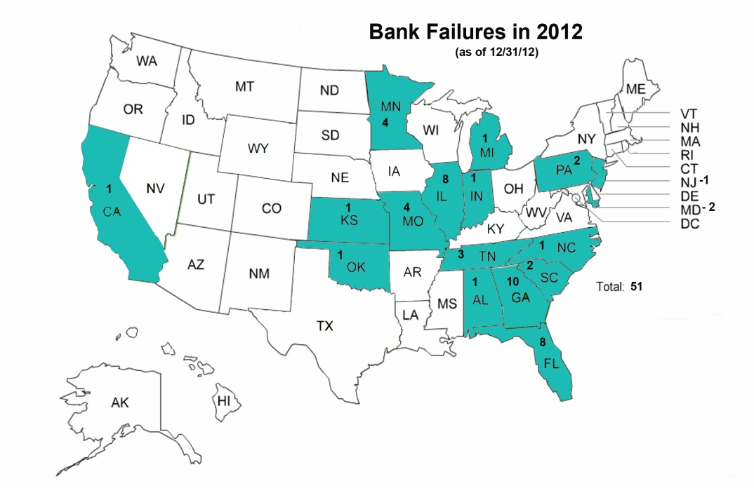
Bank Failures – Commercial Banks
Source: FDIC

Slide 7
Bank Failures in Texas Since 2008
Bank Name | Type | City | Month
2008
Franklin Bank, SSB | State Savings | Houston | November
Sanderson State Bank | State Bank | Sanderson | December
2009
Millennium State Bank of Texas | State Bank | Dallas | July
Guaranty Bank | Federal Thrift | Austin | August
Citizens National Bank | National | Teague | October
Madisonville State Bank | State Bank | Madisonville | October
North Houston Bank | State Bank | Houston | October
2010
The La Coste National Bank | National | La Coste | February
2011
First International Bank | State Bank | Plano | September
Source: FDIC

Slide 8
FDIC Problem Banks
The FDIC defines problem banks as any financial institution with a composite rating of “4” or “5”.
* As of September 2012

Slide 9
Department Problem Banks
The DOB defines problem banks as any financial institution with a composite rating of “3”, “4” or “5”.

Slide 10
Agency Highlights
Limited Number of Bank Failures: From 2008 through 2012, 462 banks failed nationwide while only five Texas state-chartered were closed in Texas.
Experienced Staff: Through enhanced training and education and the ability to offer competitive salaries, the Department has been able to attract and retain a highly-qualified professional staff implementing the “Tough but Fair” motto.
Sound Fiscal Management: No material changes to bank assessments since 2003.
In FY 2012:
95% of the banks received examinations when due.
254 examinations performed
100% bank, foreign bank, trust company, trust department, IT, and other specialty examinations or reviews were performed.
440 examinations performed
92% Special Audit licensee examinations were performed by the Department.
542 examinations performed

Slide 11
Agency Highlights
Leadership Role in Promoting Cyber Security: Corporate Account Takeovers (CATO) is a form of identity theft where cyber thieves gain control of a business’s bank account and then initiate fraudulent wires and ACH transactions. The Texas Department of Banking and banking industry representatives in conjunction with the U.S. Secret Service formed the Texas Bankers Electronic Crimes Task Force. The Task Force developed a list of best practices and the Department issued minimum standards to Texas state-chartered banks to enhance risk management in this area.
This initiative has proven to be very successful and in December 2012, the Conference of State Bank Supervisors (CSBS), the U.S. Secret Service, and the Financial Services-Information Sharing and Analysis Center (FS-ISAC) announced the adoption of these best practices to be utilized by financial institutions nationwide.

Slide 12
State Bank Challenges in Today’s Economy
Increasing regulatory burden stemming from the financial crisis, i.e. Dodd-Frank, Basel III.
Monitoring and evaluating the drought conditions on communities and institutions, especially in regard to credit availability and other services.
Managing troubled assets and engaging in robust servicing and collection practices.
Managing a narrowing net interest margin in a low rate environment.
Seeking revenue diversification through noninterest income sources.

Slide 13
Possible Legislation
Banks and Trust Companies: Change requirement for monthly board meetings, revise loan production office requirements, define surplus, clarify ability of advisory directors to receive confidential information, revise terms to be consistent with the Business Organization Code, and correct references.
Prepaid Funeral Contracts: Clarify permit renewal types, grant authority to issue subpoenas for investigations, clarify hearing process, and grant authority to issue prohibition orders.
Perpetual Care Cemeteries: Clarify when it is necessary to file an amended plat map, clarify the minimum capital requirement for each cemetery, and make it a criminal offense for unauthorized multiple burials.
Money Services Businesses: Allow the agency to use the National Mortgage Licensing System database, define prepaid access, eliminate license renewals, broaden the definition of currency exchange and correct references.
Criminal History Information: Add authority to obtain criminal history information on perpetual care cemetery owners, clarify authority to obtain criminal history on department employees, and correct references.

