Slide 1
Senate Finance Committee HEARING
February 23, 2011
Charles G. Cooper, Banking Commissioner
Texas Department of Banking

Slide 2
Department Overview
Established in 1905 by the 29th Legislature.
Rich tradition of professional and sound regulation.
Practices and promotes fiscal responsibility.
Reduces regulatory burden by coordinating regulatory activities with other state and federal agencies.
Our mission is to ensure Texas has a safe, sound and competitive financial services system.
Regulatory oversight in the banking industry is countercyclical, and during times of economic stress there is an increased need for supervision.
Department Motto – “Tough but Fair.”

Slide 3
Profile of Regulated Entities
Regulated Entities | Number of Entities
As of December 31, 2010
Commercial Banks | 314
Public Trust Companies | 20 Nonexempt 22 Exempt
Foreign Bank Agencies | 10 FBAs 18 Representative Offices
Money Service Businesses | 133
Prepaid Funeral Contract Sellers | 403
Perpetual Care Cemeteries | 244
Private Child Support Enforcement Agencies | 10*
Check Verification Entities | 4*
The Department conducts examinations of entities under its supervision to ensure entities operate in a safe and sound manner and are in compliance with state and federal laws. Assets of the regulated entities represented in the table are
approximately $360 billion.
* Registration requirement only

Slide 4
81st Legislative Session – HB 2774
SDSI Authority and Requirements
Statutory Authority: Texas Finance Code, §16.002
Requirements:
Annual budget approved by Finance Commission.
Agency responsible for all direct and indirect costs; no cost to General Revenue Fund.
  Must pay employee benefits and charges from other state agencies (i.e. Attorney General, State Auditor, and other state agencies, etc.).
Funds maintained at Texas Treasury Safekeeping Trust.
  State Auditor’s Office may conduct audits, including financial reports and performance audits.
  Quarterly financial statements are submitted to the Finance Commission for review and approval.

Slide 5
81st Legislative Session – HB 2774 (continued)
Annual report submitted to Governor, House Appropriations, Senate Finance and LBB (Exhibit A - Submitted October 2010):
Salary of agency personnel and travel expenses, including Commission travel;
Agency operating plan and annual budget; and
Detailed report of revenues and expenditures for previous 12 months.
Biennial activity report submitted to Legislature and Governor to include (Exhibit B - Submitted December 2010):
Any audit performed by the State Auditor;
Financial report of previous fiscal year; and
Description of all new rules and changes in fees imposed on regulated industries.

Slide 6
Revenue Sources
The Department is fully self-funded and fully self-leveling.
  Fees and assessments on regulated entities fund 100% of the agency’s expenditures.
  By statute, the Department of Banking is limited to collecting fees and assessments that cover only the agency’s direct and indirect expenditures.
Expenses
  The agency has continued to follow the State Payroll, Travel, Purchasing and Procurement rules and standards for all agency expenditures.
  Salaries and other personnel expenses average 83% of total expenditures.
  Travel related expenses, mainly to conduct examinations, average 9% of total expenditures.

Slide 7
Agency Budget Process
FY 2010 Budget
The FY 2010 budget was approved by the Finance Commission in August 2009 after SDSI was granted by 81st Legislature.
  This budget was substantially the same for expenditures appropriated by the 81st Legislature which included increased personnel for problem banks and competitive salary adjustments for financial examiners and related directors.
The budget included no change in fee structure.
Actual FY 2010 expenditures were 8% less than the amounts appropriated by the 81st Legislature.
The unrestricted fund balance at fiscal year end of $3.7 million meets the Government Finance Officers Association's recommended best practices of a minimum of two months of regular operating expenses.

Slide 8
Agency Budget Process
FY 2011 Budget
A public hearing was held on July 20, 2010, to accept comments on the agency’s proposed 2011 budget.
The budget included no change in fee structure.
The Finance Commission approved the agency’s budget at their August 2010 meeting.
  This budget was 3% greater than the expenditures appropriated by the 81st Legislature.
  Budget is for 196 FTEs. Of these 140 are financial examiners.
FY 2012 Budget
Budget process begins in Spring 2011.
Department does not anticipate a significant increase in its budget for FY 2012 or 2013.

Slide 9
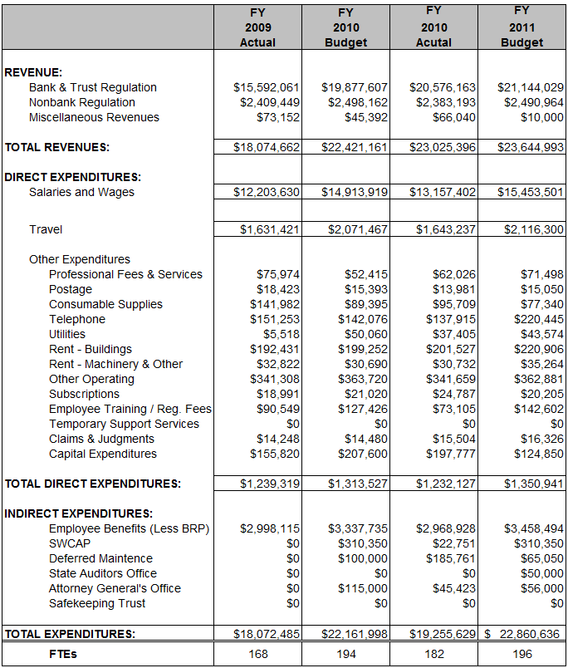
Agency Financials
Differences between
2010 Actual and 2011 Budget
Staffing
  Financial examiner positions filled for the entire year
  2 new Financial Examiners
  Competitive salary adjustments for Financial Examiner series
  More travel for larger examiner staff, problem bank examinations and deferred examiner training classes.
  Subscriptions to analytical data, trends and capital market business news services for improved regulatory oversight (Bloomberg and Invictus).
  Training classes cancelled by outside vendors in 2010 were rescheduled for 2011.

Slide 10
Accomplishments
In August 2009, there were 10 financial examiners and 14 limited term employees vacancies. As of February 15, 2011, there were 2 financial examiners and 3 limited term employees vacancies.
Completion of Revenue Accounting Process audit by an outside accounting firm and Post Payment audit by the Comptroller of Public Accounts with no material findings in either.
Agency fulfilled examination priorities while also assisting federal counterparts with their examinations.
  In FY 2010:
    94% of banks received examinations when due. (16 past due at 8/31/2010)
    464 bank, foreign bank, trust company, trust department, IT, and other specialty examinations or reviews were performed. (4 past due at 8/31/2010)
    594 Special Audit licensee examinations were performed. (14 past due at 8/31/2010)
Turnover Rate
FY 08 | FY 09 Anticipation of Competitive Salary Adjustments | FY 10
11.4% | 8.8% | 6.2% lowest in 11 years

Slide 11
State Bank Challenges in Today’s Economy
Managing troubled assets and engaging in robust servicing and collection practices.
Acquiring stable and reasonably priced funding sources.
Managing a narrowing net interest margin in a low rate environment.
Seeking revenue diversification through noninterest income sources.
Navigating and adapting to a changing regulatory environment (Dodd-Frank).

Slide 12
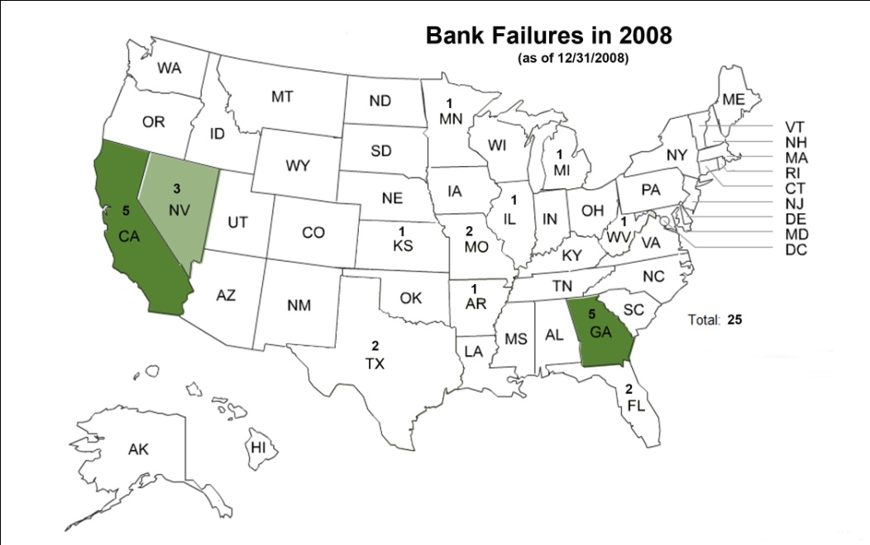
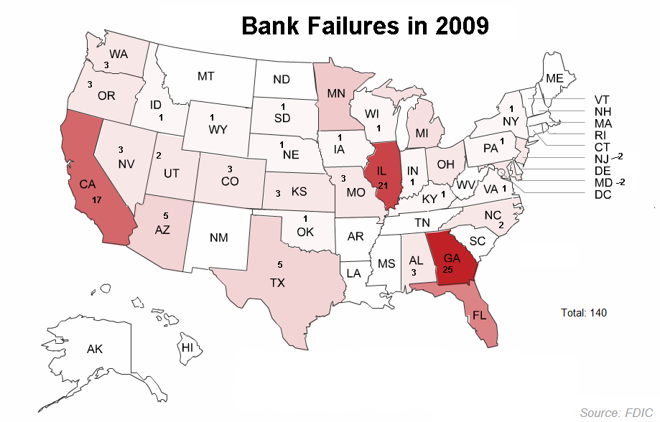
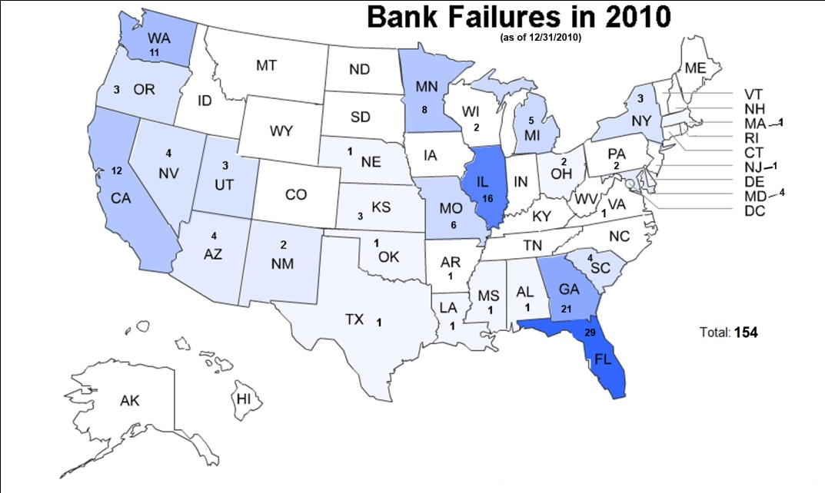
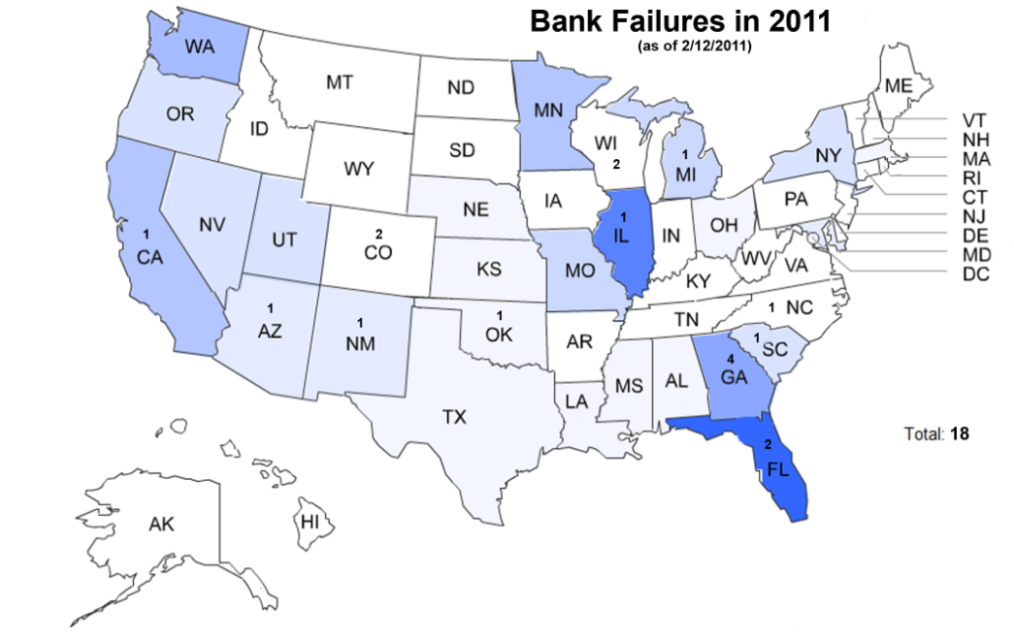
Bank Failures – Commercial Banks
(as of 12/31/2009)
Source: FDIC

Slide 13
Assets Under Supervision in Texas
Source: FDIC

Slide 14
Exhibits

